Slide 1
Predicting Winner of LOL Match
Team 7
Jianchao Li 1054645
Lin zhu 1066973
Yihao Gu 1305641

Slide 2
Introduction
Use Cases
Methodology
Data Sources
Milestones
Program in Scala
Criteria
Goals

Slide 3

Introduction
Two teams 5 v 5 battle
The game is often cited as the world's largest esport (https://en.wikipedia.org/wiki/League_of_Legends)
Prediction on it will be very useful

Slide 4
Data Sources
League of Legends, Competitive matches, 2015 to 2018:
https://www.kaggle.com/chuckephron/leagueoflegends
There are five different datasets:
gold.csv contains 99061 rows
kills.csv contains 191070 rows
matchinfo.csv contains 7621 rows
mosters.csv 44249 rows
structures.csv 121387 rows

Slide 5
Program In Scala - 95.6%
Data preprocessing
Spark Mllib
Play2.X Framework *Left 4.4% part of project are written by HTML and CSS
All unit tests
Github Repository: https://github.com/ljch9725/CSYE7200_Final_Project_Team7

Slide 6
Milestones
Week 1: Self-learn related Spark, Scala and Play skills. Clean data and do data analysis. Implement data unit test
Week 2-3: Select all possible models; train models and get the best model. Implement model unit test.
Week 4: Implement UI by Play framework. Add comments and optimize codes.
Week 5: Prepare presentation

Slide 7
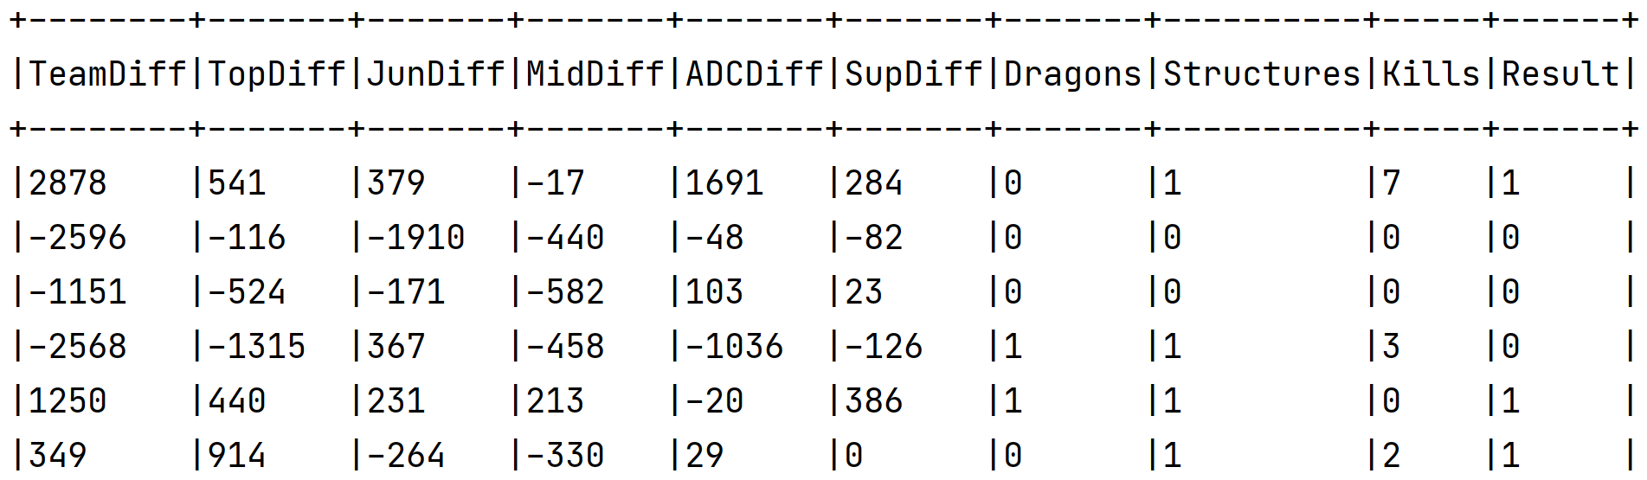
Preprocess Data
Select and extract useful information as features from five datasets.
The prediction dataset we got is as follow (first 6 rows):

Slide 8
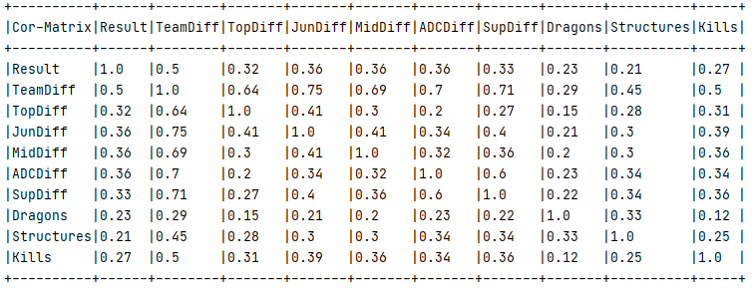
Data Analysis
Calculate the correlation of all features and label

Slide 9
Acceptance Criteria
Confusion Matrix:
 | True Class
Predicted Class | Positive | Negative
Positive | True Positive(TP) | False Positive(FP)
Negative | False Negative(FN) | True Negative(TN)
Accuracy = (TP + TN)/(P + N)
Accuracy > 70%
Response Time < 4 seconds

Slide 10
Goals of Project
Design a completed predicting system based on match histories.
Use information of first 15 minutes in the match to predict the final winner.
Learn related knowledge about Scala, Spark, Machine learning and Big data.

Slide 11
Use Cases
Potential users input required information of one LOL match at first 15 minutes
System predicts which side will win based on the selected model

Slide 12
Thank You

